Slide 1
1
CSE 427: VIRTUALIZATION & CLOUD COMPUTING
LAB
VMWARE TYPE – I INSTALLATION
by
Mr. Ajay Kumar Badhan
Assistant Professor
M.TECH[CST], B.TECH [CSE]
Email: ajay.27337@lpu.co.in
Personal Blog: https://ajaykumarbadhan.wordpress.com/
Preferred Text Book
Cloud Computing Bible: Barrie Sosinky – 1st Edition, Wiley India Pvt. Ltd.
Cloud Computing: Fundamentals, Industry Approach & Trends by Rishabh Sharma, Wiley
Cloud Computing: Principles & Paradigms by Raj Kumar Buyya, James Broberg, Andrzej Goscinski, Wiley
@Mr. Ajay Kumar Badhan

Slide 2
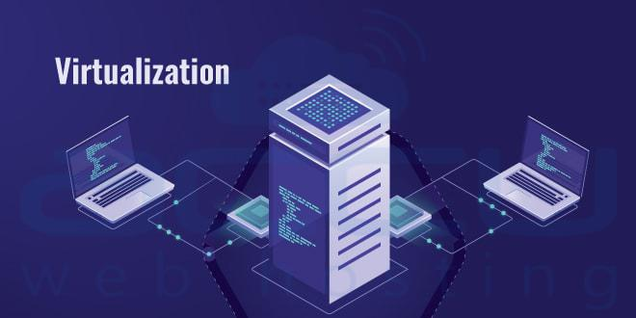
2
PART -I: VIRTUALIZATION
CONTENT
VIRTUALIZATION TECHNIQUES
Virtualization Technology
Overview of x86 Architecture
Types of Virtualization
Concepts of VLAN
Concepts of SLAN
Concepts of VSAN
Benefits of VLAN, SLAN, & VSAN
@Mr. Ajay Kumar Badhan

Slide 3
3
PART - I: VIRTUALIZATION
TYPE – II HYPERVISOR
INTRODUCTION TO TYPE – II HYPERVISOR
Type 2 Hypervisor is called a Host OS Hypervisor. These hypervisors execute on an operating system similar to other computer programs. For example, assume that there is an operating system. There is a hypervisor on top of the OS. It provides an emulator environment to run another operating system.
Example: VMware.
Type 1 hypervisor is a hypervisor that runs directly on the host’s hardware to control the hardware and to manage guest operating systems. Now we will work on a type-1 hypervisor through “Hands-on Lab”.
Hands-on Labs are the fastest and easiest way to test-drive the full technical capabilities of VMware products. These evaluations are free, up and running on your browser in minutes, and require no installation.
This introductory lab demonstrates the core features and functions of vSphere and vCenter. It is an excellent place to begin your experience with VMware vSphere
@Mr. Ajay Kumar Badhan

Slide 4
4
PART - I: VIRTUALIZATION
vSphere
Introduction To vSPHERE
It is a software suite that comes under data center product. vSphere is like Microsoft Office suite which has a lot of software like MS Office, MS Excel, MS Access, and so on.
Like Microsoft Office, vSphere is also a software suite that has many software components like vCenter, ESXi, vSphere client, and so on. So the Combination of all these software components is vSphere.
It is not a particular software that you can install and use, “it is just a package name which has other subcomponents”.
ESXi, vSphere client, and vCENTER are components of VMware vSphere.
ESXi server is the most important part of vSphere.
ESXi is the virtualization server. It is a type 1 hypervisor. All the virtual machines or Guest OS are installed on the ESXi server.
@Mr. Ajay Kumar Badhan

Slide 5
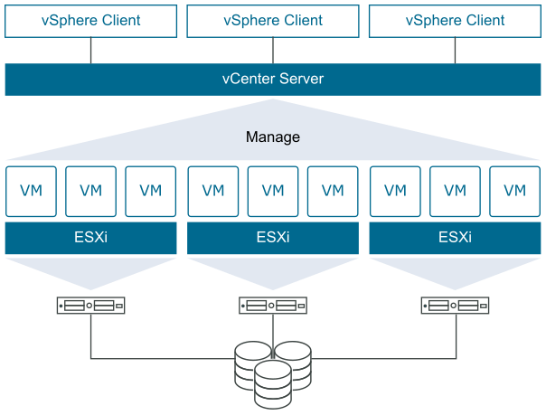
5
PART - I: VIRTUALIZATION
ESXi & vCENTER
Introduction To ESXi
ESXi is a hypervisor or a type of virtualization software that allows you to create and manage multiple virtual machines using a single physical host.
It is installed directly on a physical machine, meaning that it is a bare-metal hypervisor.
vCENTER
VMware vCenter Server allows for centralized management of your virtual infrastructure. You can control your hosts and VMs from a single console, which enhances visibility and helps with error prevention.
@Mr. Ajay Kumar Badhan

Slide 6
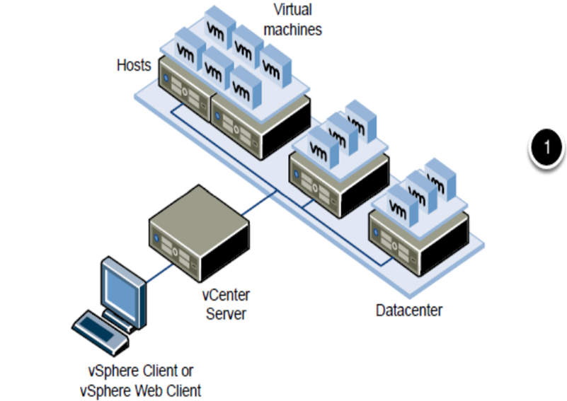
6
PART - I: VIRTUALIZATION
vSphereClient
Introduction To vSphereClient
Use the vSphere Client to connect to vCenter Server systems and manage vSphere inventory objects.
Use of the vSphere Client requires a supported Web browser.
The home screen of the vSphere Client is a system dashboard that aggregates data from different sources in the environment together in a single, unified view.
@Mr. Ajay Kumar Badhan

Slide 7
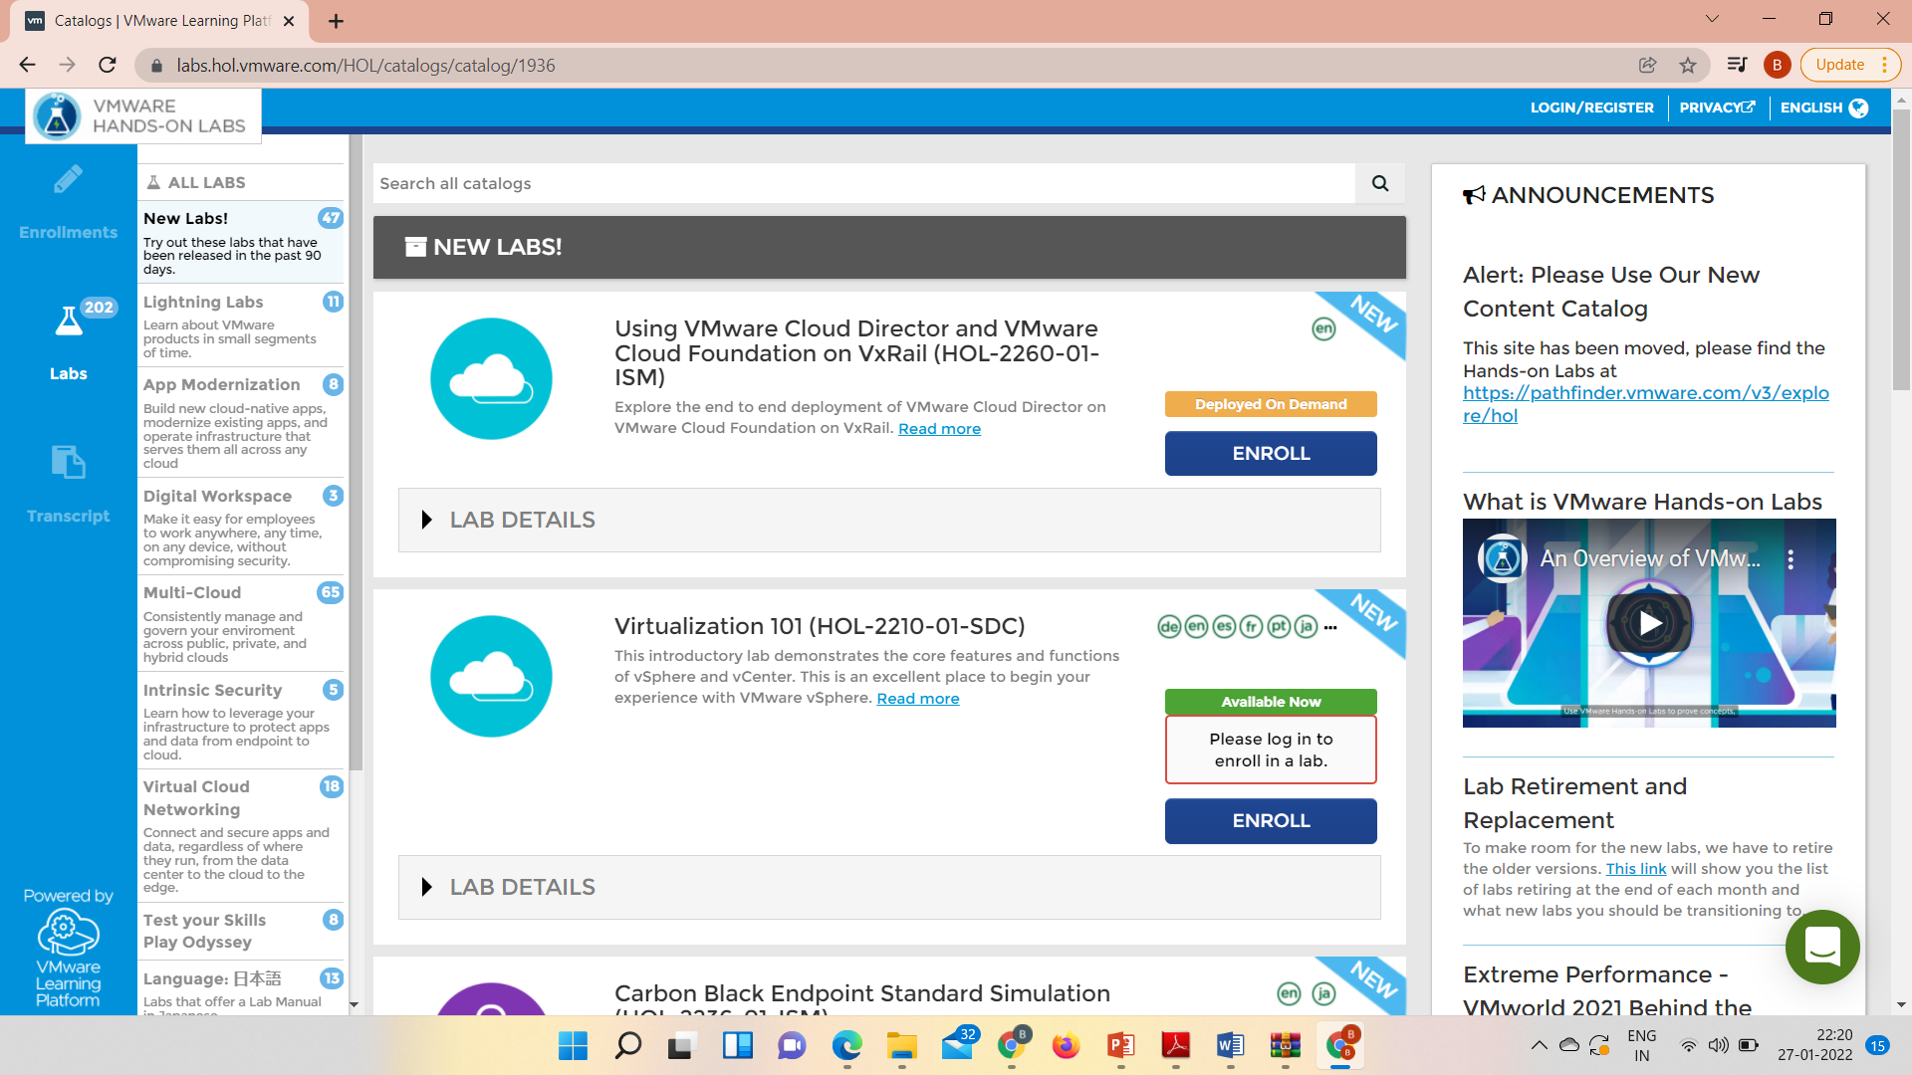
7
PART - I: VIRTUALIZATION
LAB WORK
@Mr. Ajay Kumar Badhan

Slide 8
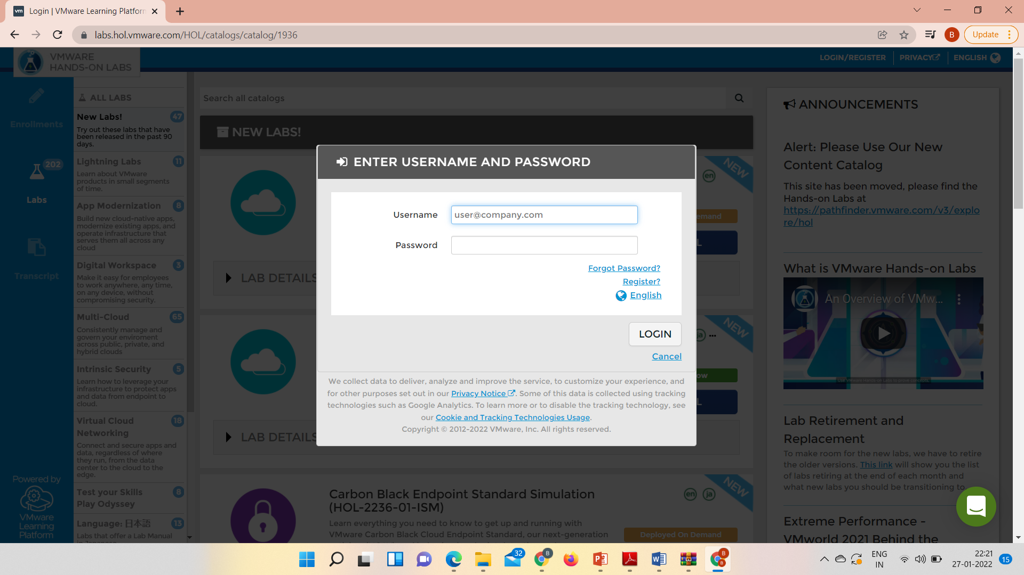
8
PART - I: VIRTUALIZATION
LAB WORK
@Mr. Ajay Kumar Badhan

Slide 9
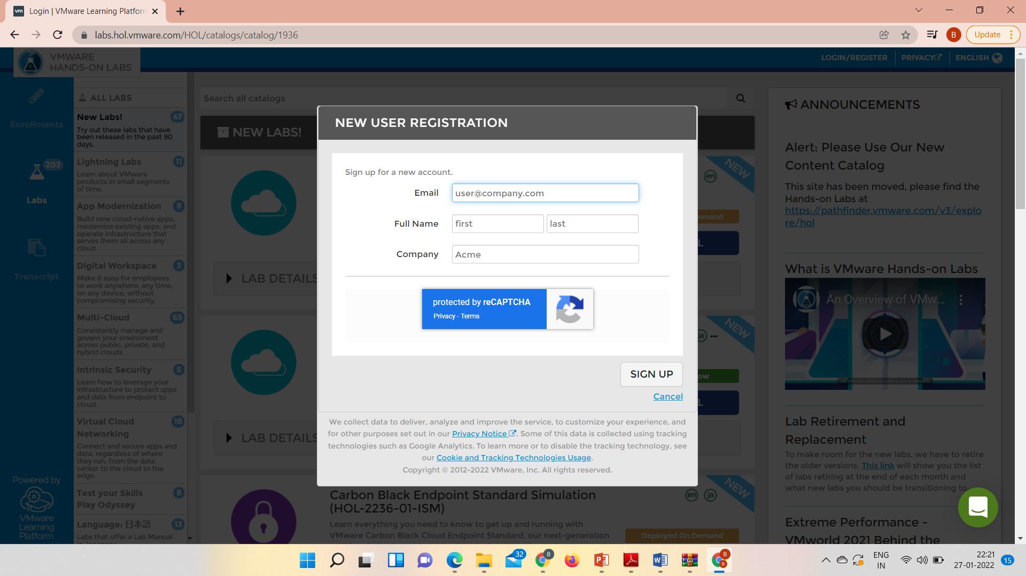
9
PART - I: VIRTUALIZATION
LAB WORK
@Mr. Ajay Kumar Badhan

Slide 10
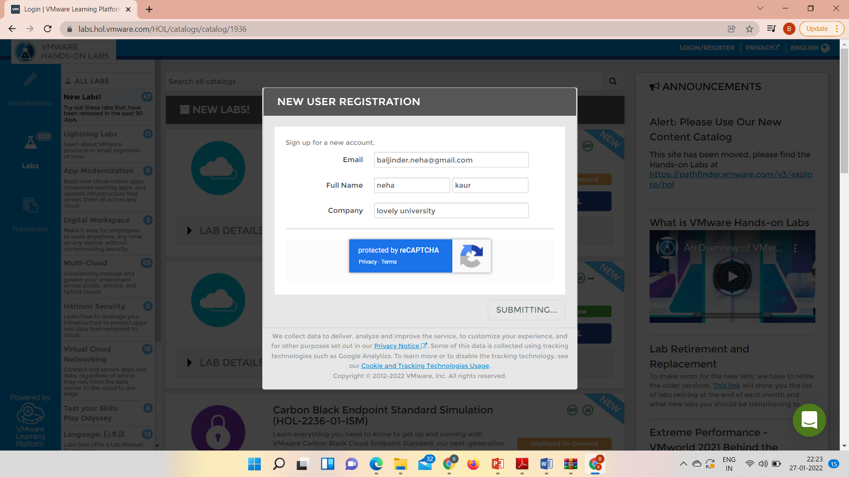
10
PART - I: VIRTUALIZATION
LAB WORK
@Mr. Ajay Kumar Badhan

Slide 11
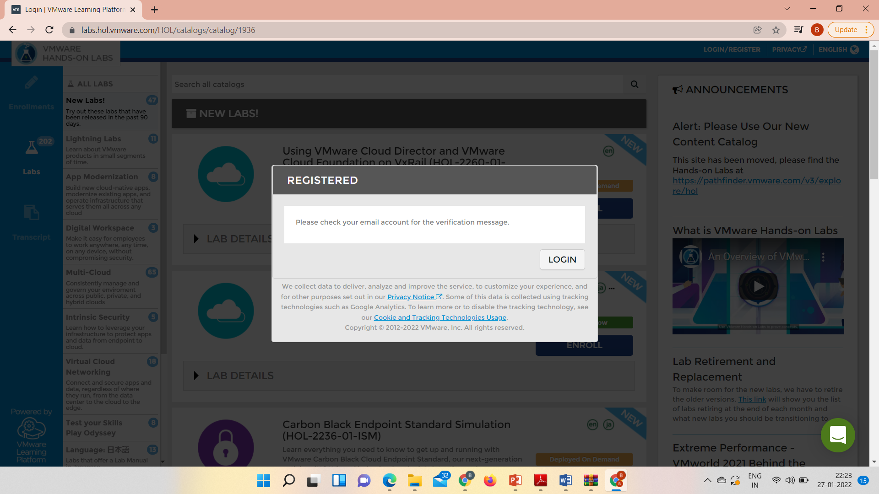
11
PART - I: VIRTUALIZATION
LAB WORK
@Mr. Ajay Kumar Badhan

Slide 12
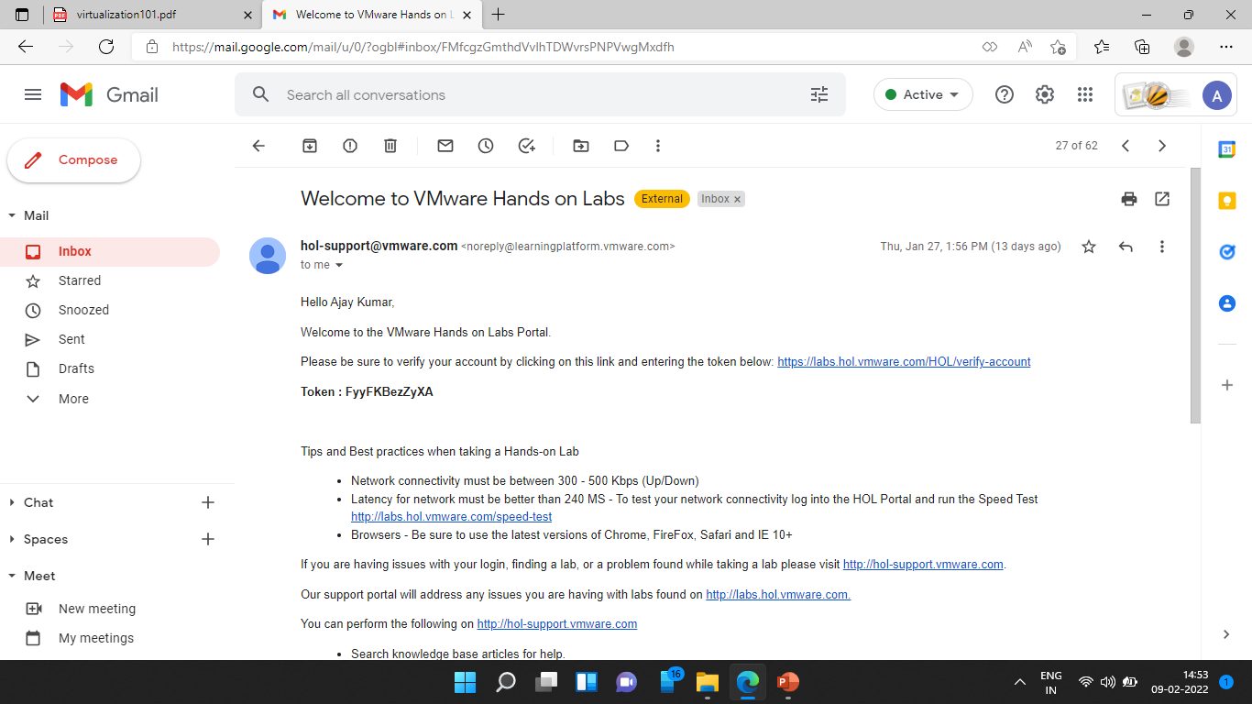
12
PART - I: VIRTUALIZATION
LAB WORK
@Mr. Ajay Kumar Badhan

Slide 13
13
PART - I: VIRTUALIZATION
LAB WORK
@Mr. Ajay Kumar Badhan

Slide 14
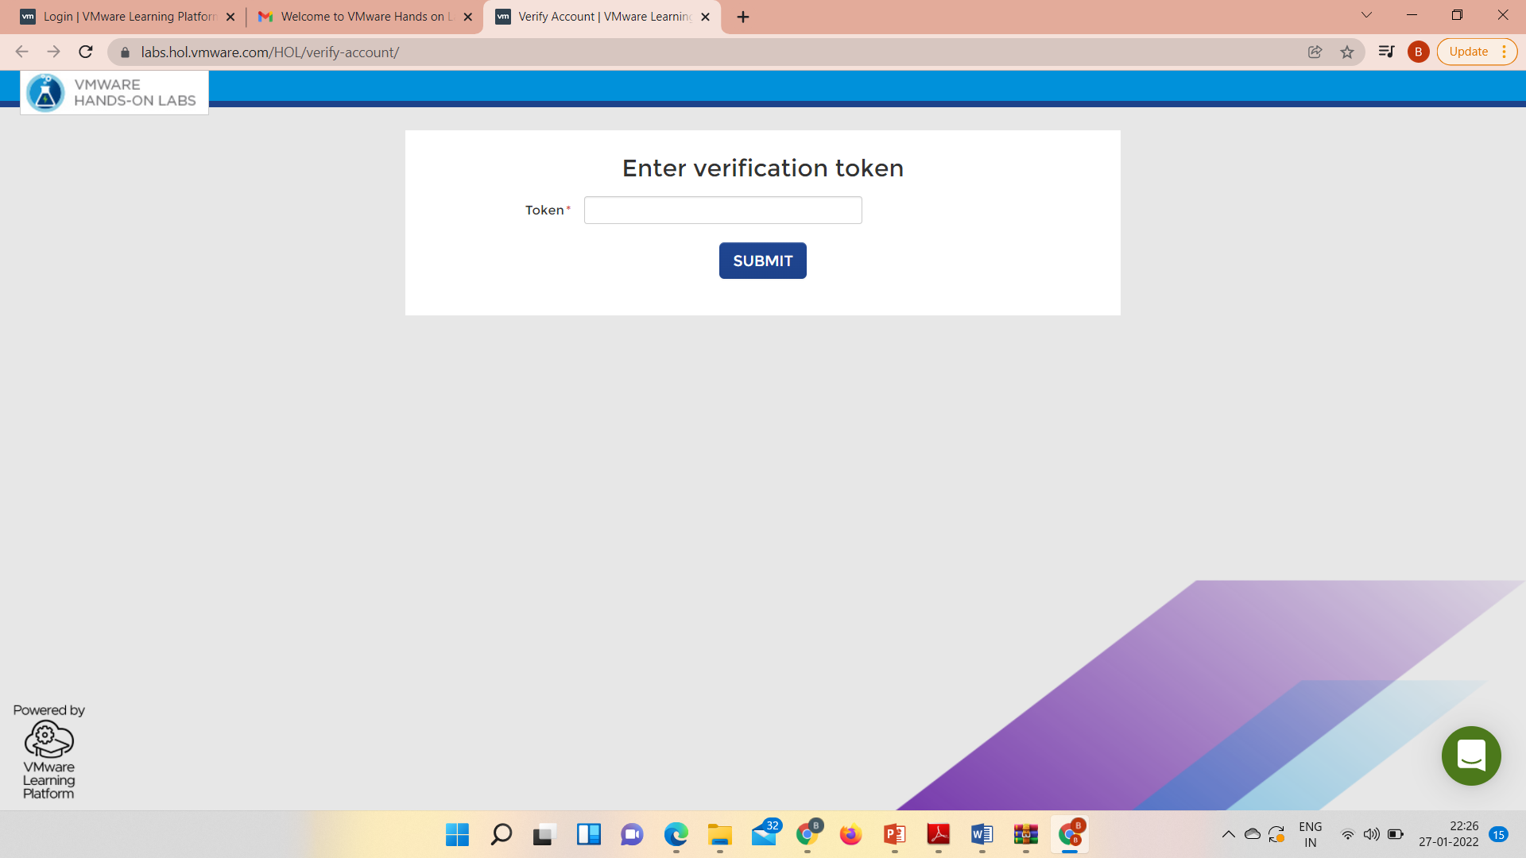
14
PART - I: VIRTUALIZATION
LAB WORK
@Mr. Ajay Kumar Badhan

Slide 15

15
PART - I: VIRTUALIZATION
LAB WORK
@Mr. Ajay Kumar Badhan

Slide 16
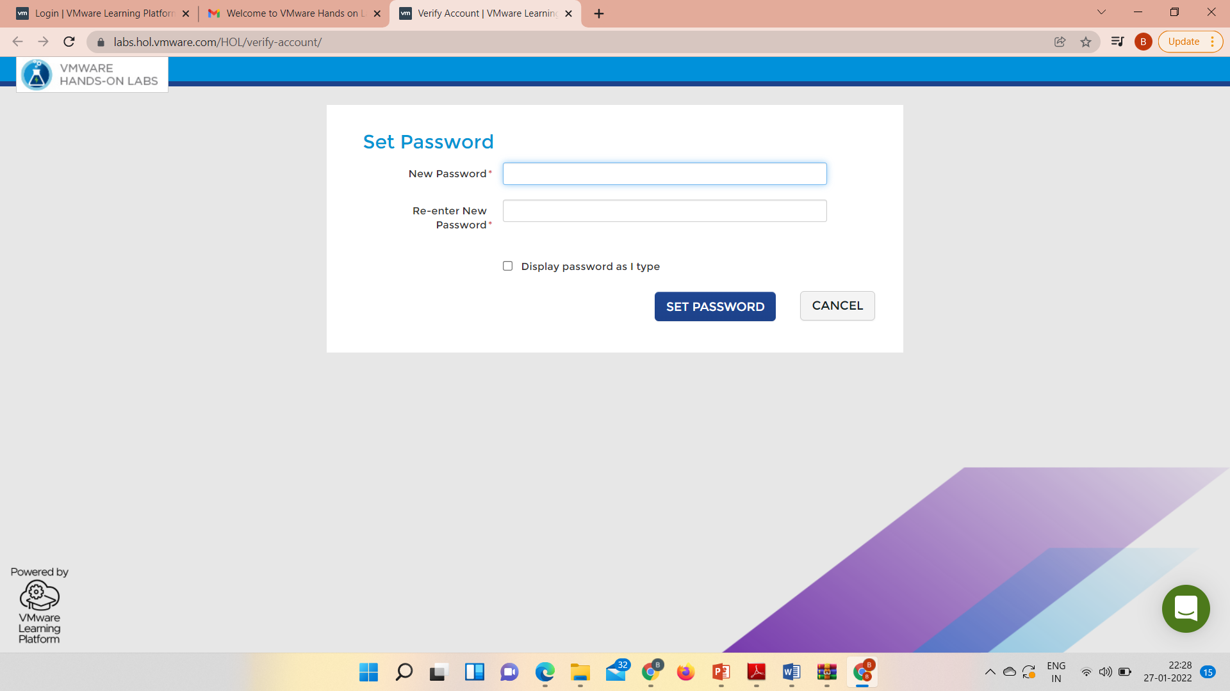
16
PART - I: VIRTUALIZATION
LAB WORK
@Mr. Ajay Kumar Badhan

Slide 17
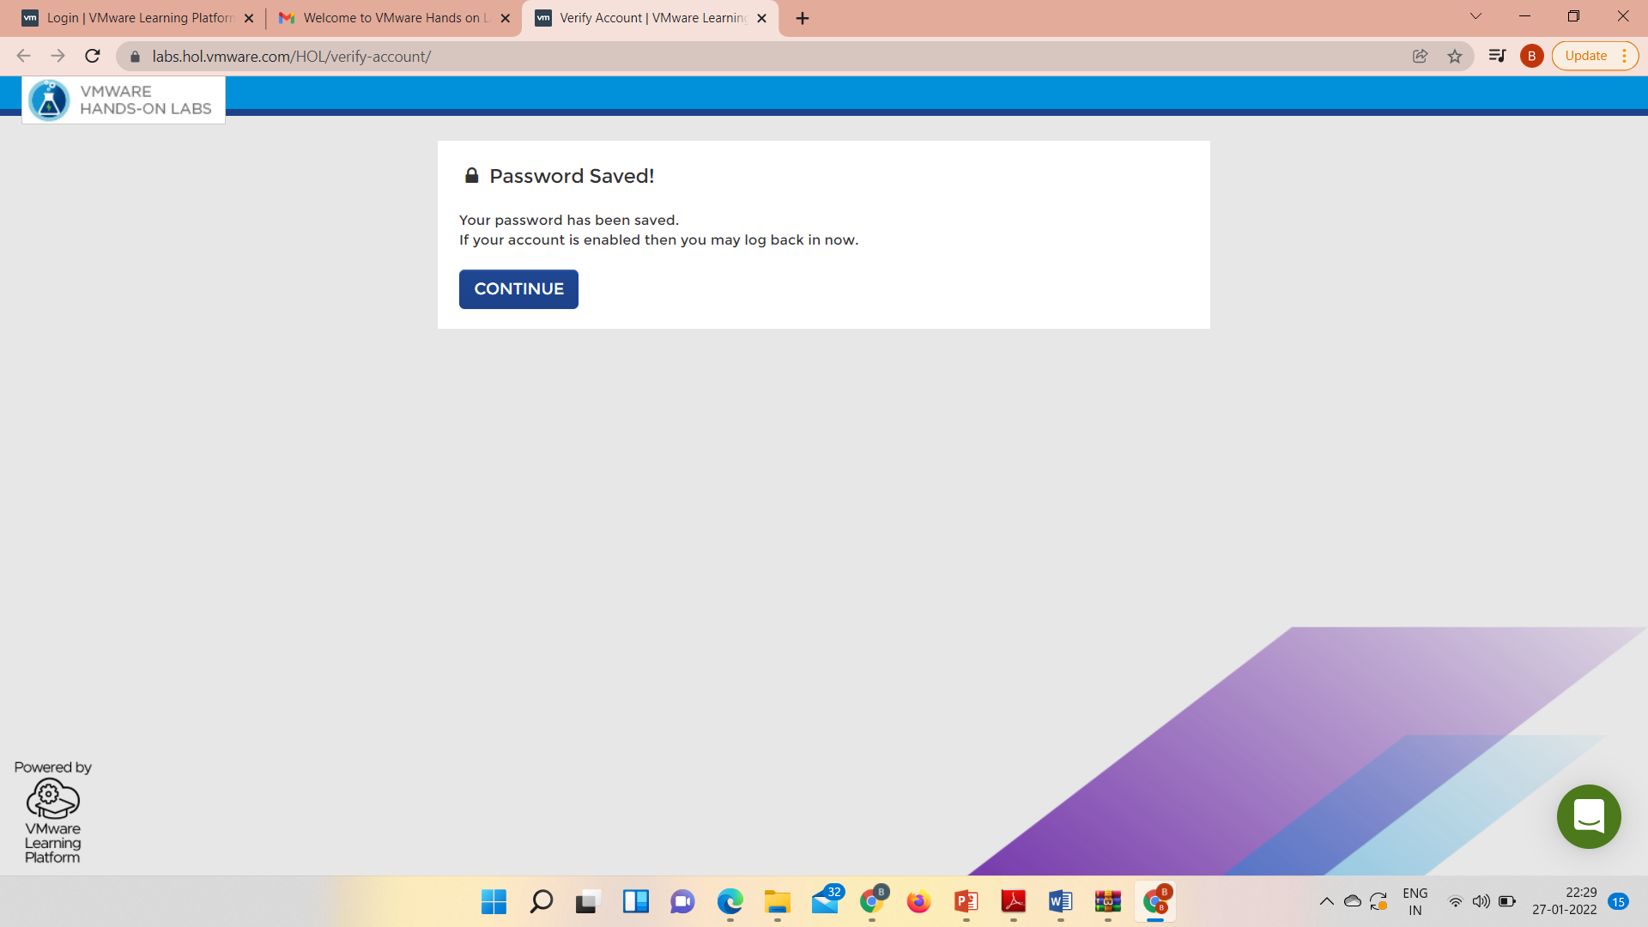
17
PART - I: VIRTUALIZATION
LAB WORK
@Mr. Ajay Kumar Badhan

Slide 18
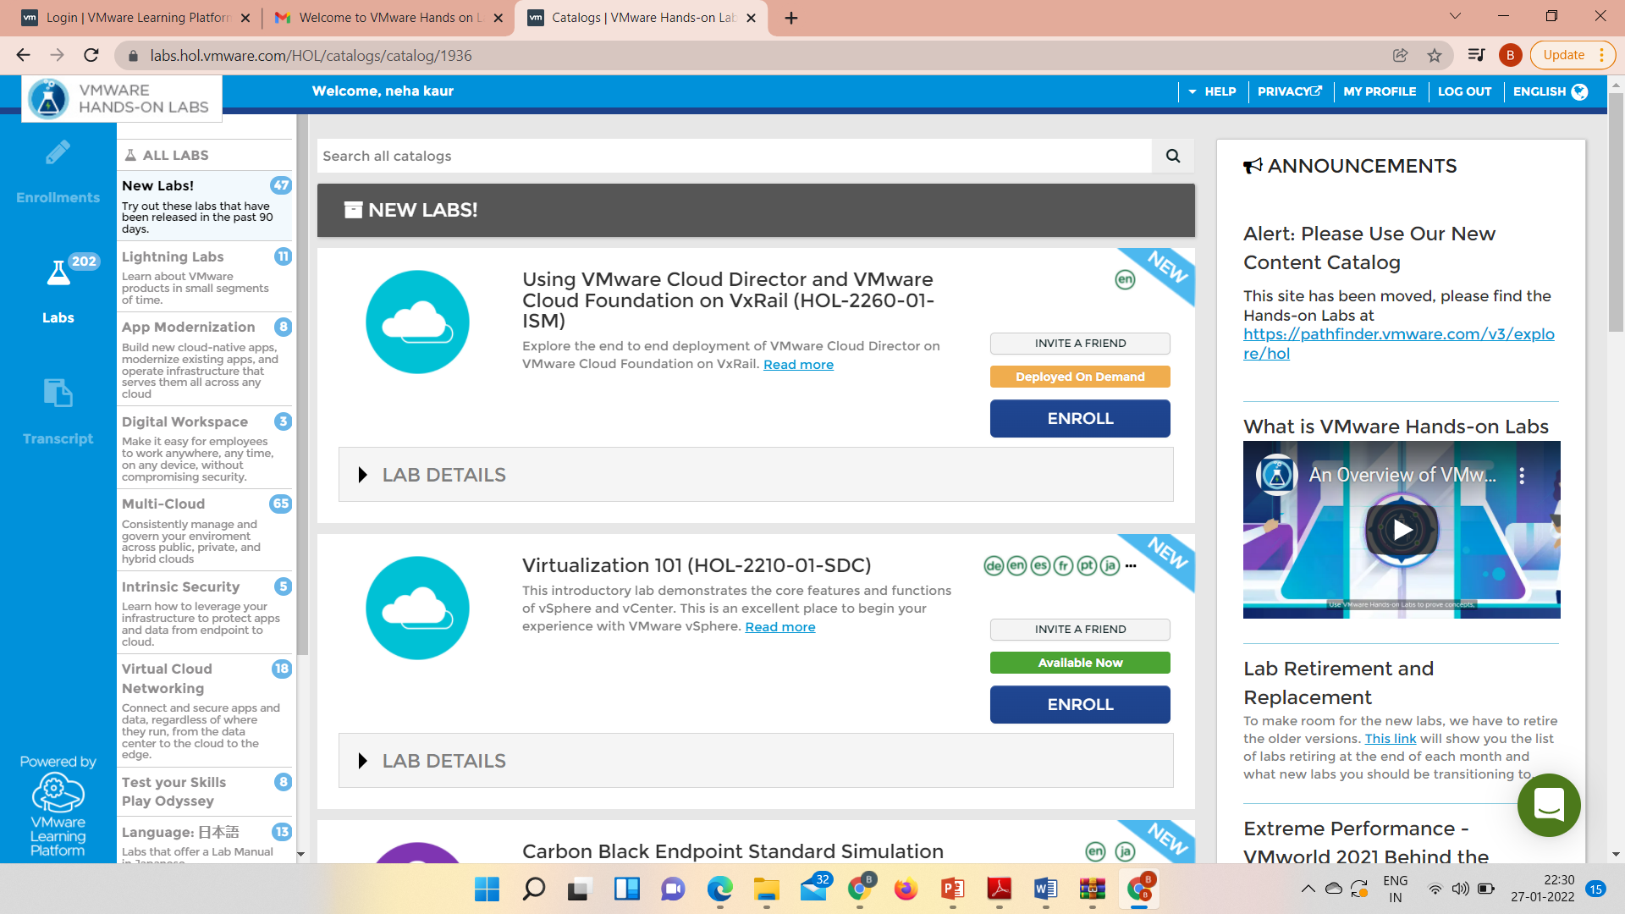
18
PART - I: VIRTUALIZATION
LAB WORK
@Mr. Ajay Kumar Badhan

Slide 19
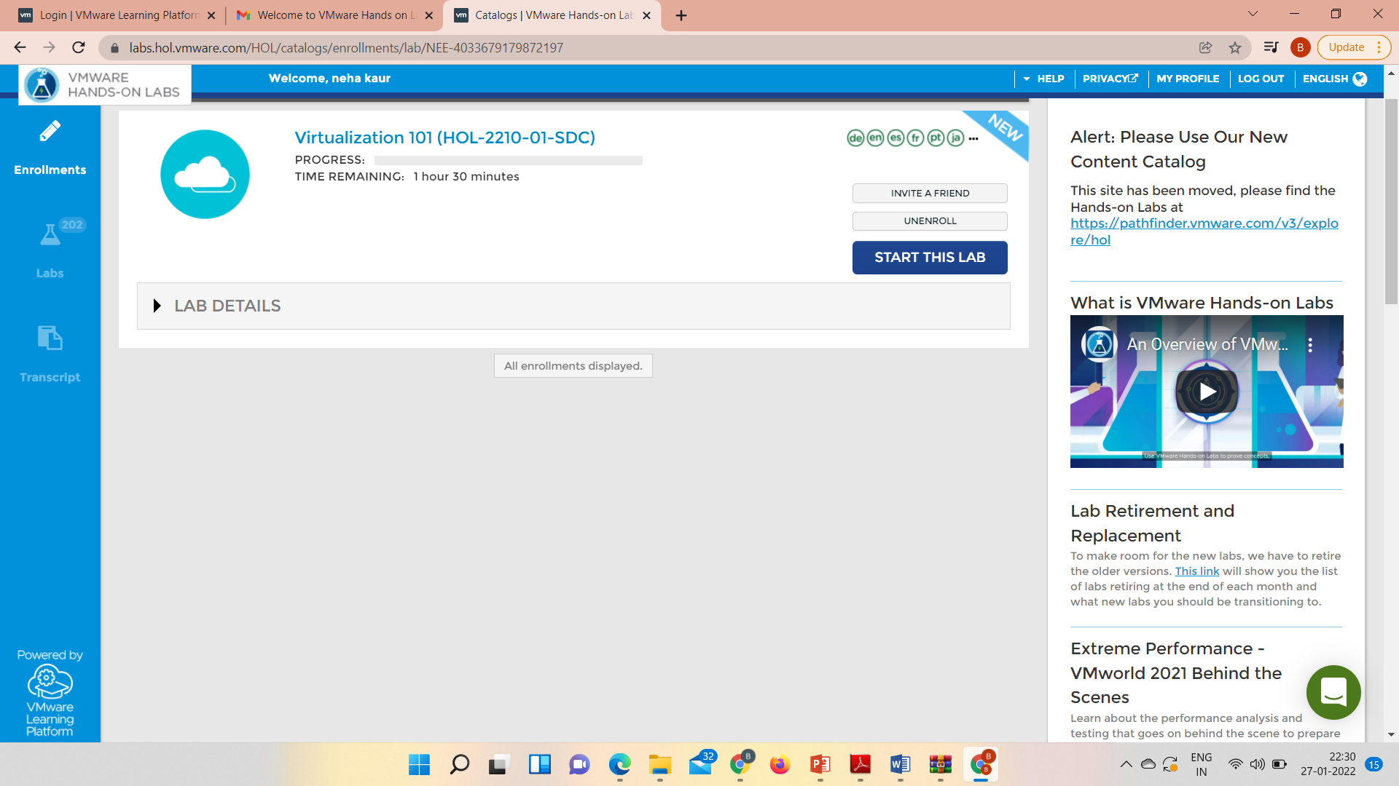
19
PART - I: VIRTUALIZATION
LAB WORK
@Mr. Ajay Kumar Badhan

Slide 20
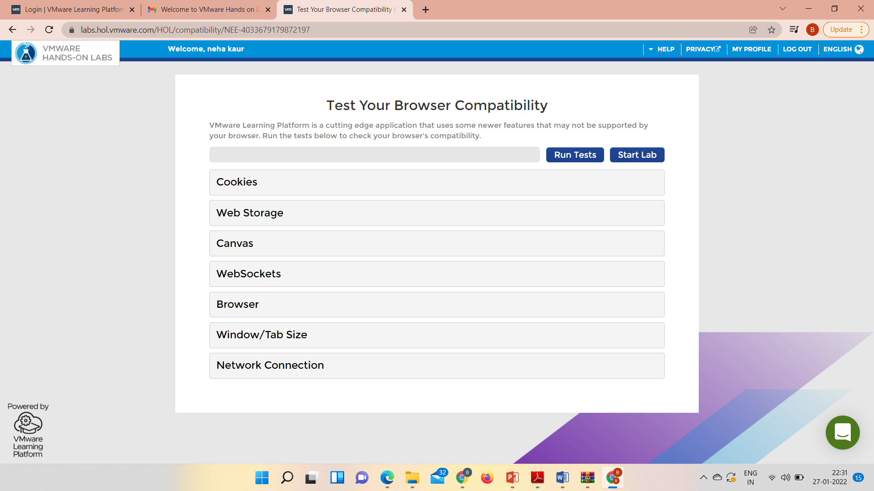
20
PART - I: VIRTUALIZATION
LAB WORK
@Mr. Ajay Kumar Badhan

Slide 21
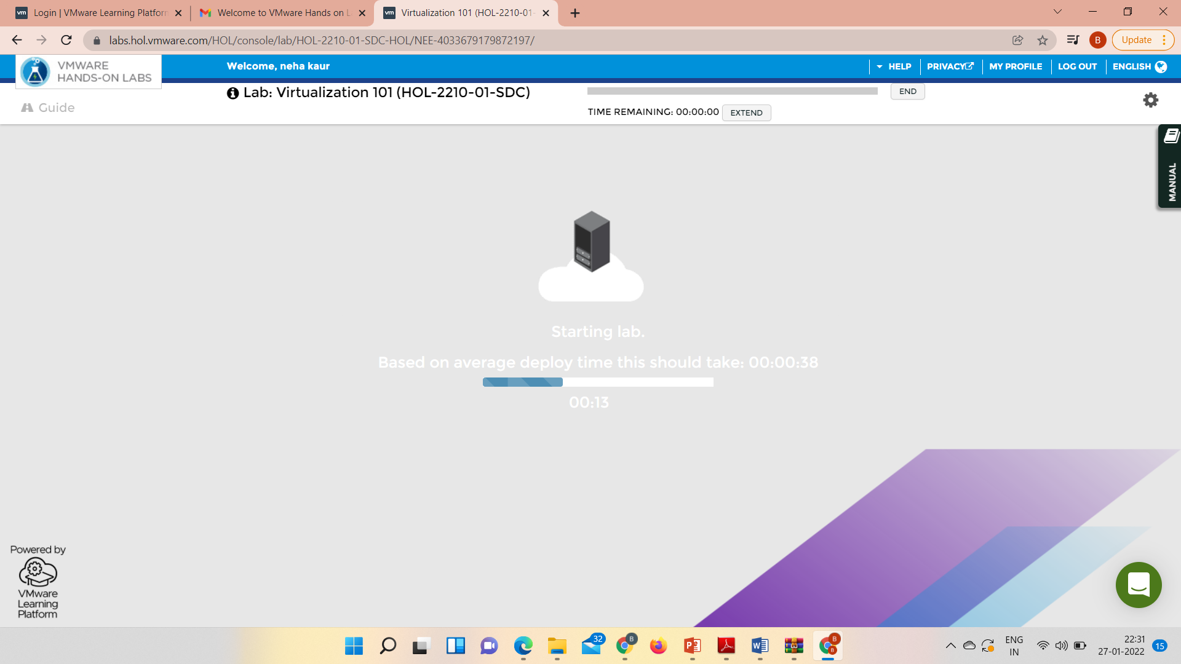
21
PART - I: VIRTUALIZATION
LAB WORK
@Mr. Ajay Kumar Badhan

Slide 22
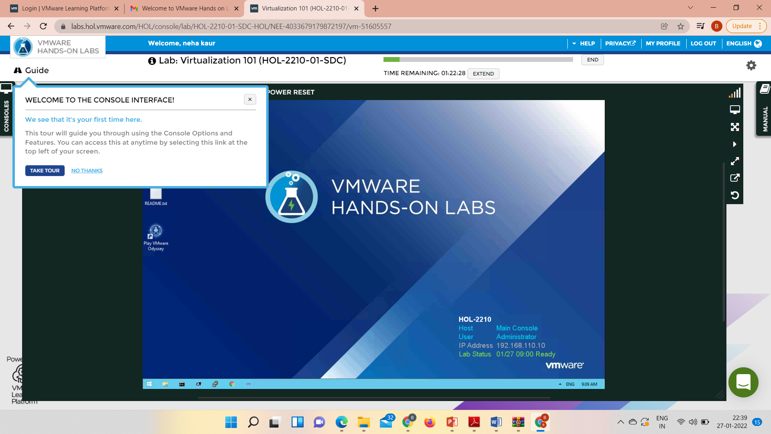
22
PART - I: VIRTUALIZATION
LAB WORK
@Mr. Ajay Kumar Badhan

Slide 23
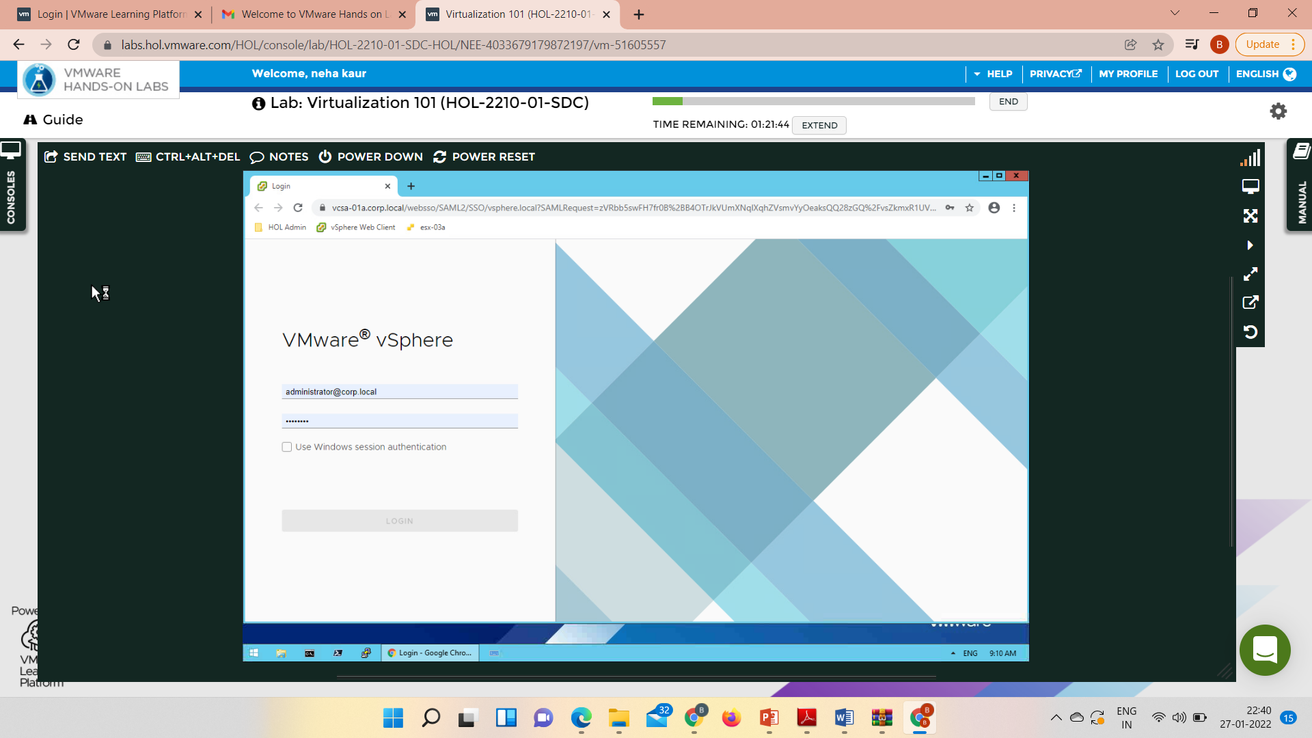
23
PART - I: VIRTUALIZATION
LAB WORK
@Mr. Ajay Kumar Badhan

Slide 24
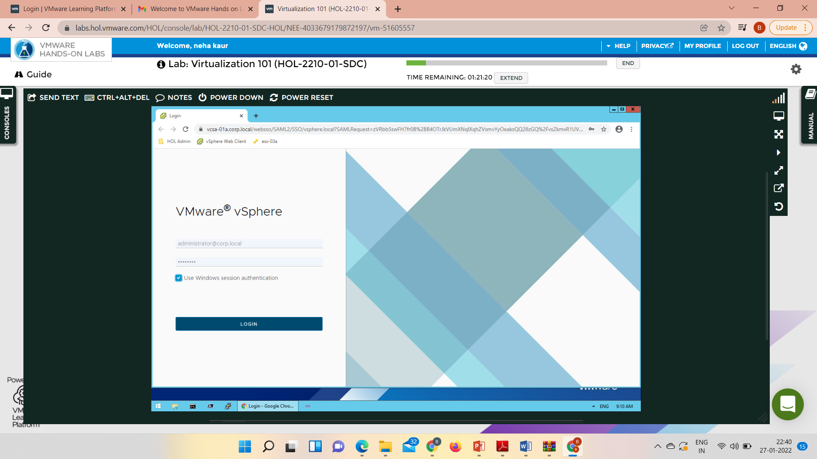
24
PART - I: VIRTUALIZATION
LAB WORK
@Mr. Ajay Kumar Badhan

Slide 25
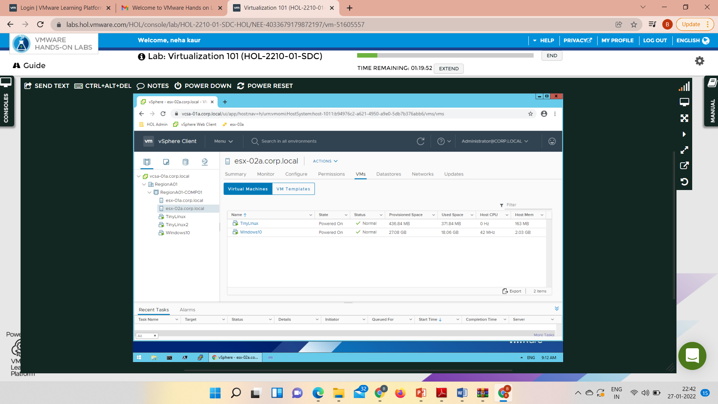
25
PART - I: VIRTUALIZATION
LAB WORK
@Mr. Ajay Kumar Badhan

Slide 26
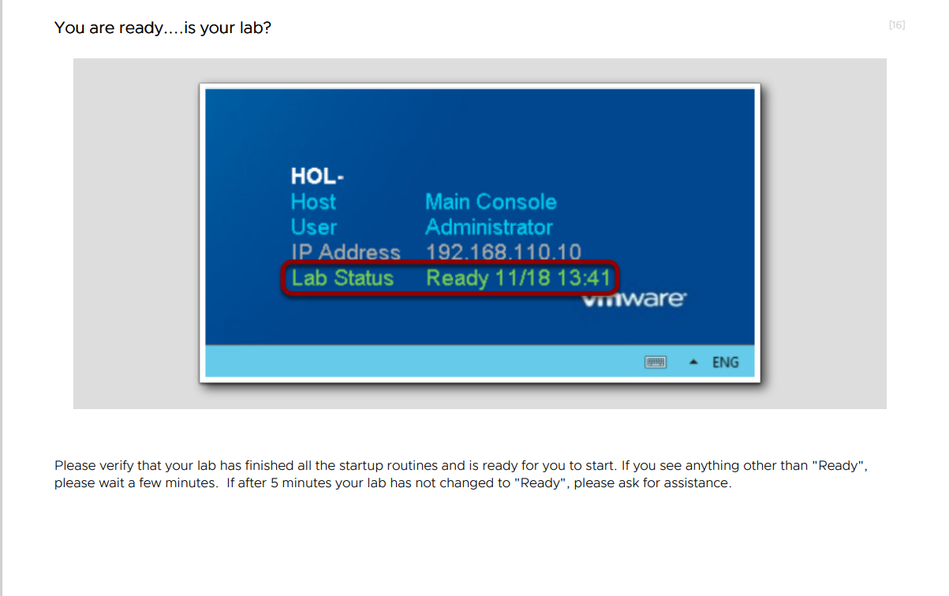
26
PART - I: VIRTUALIZATION
LAB WORK
@Mr. Ajay Kumar Badhan

Slide 27
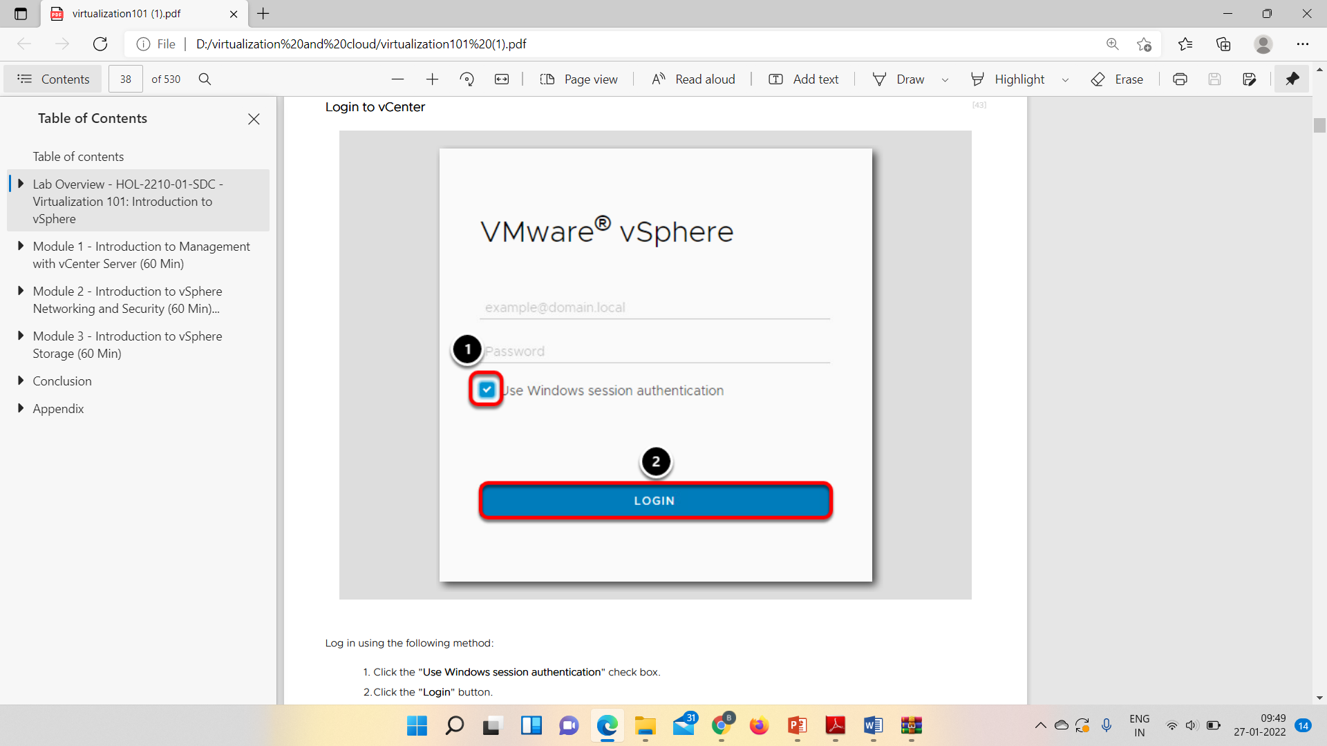
27
PART - I: VIRTUALIZATION
LAB WORK
@Mr. Ajay Kumar Badhan

Slide 28
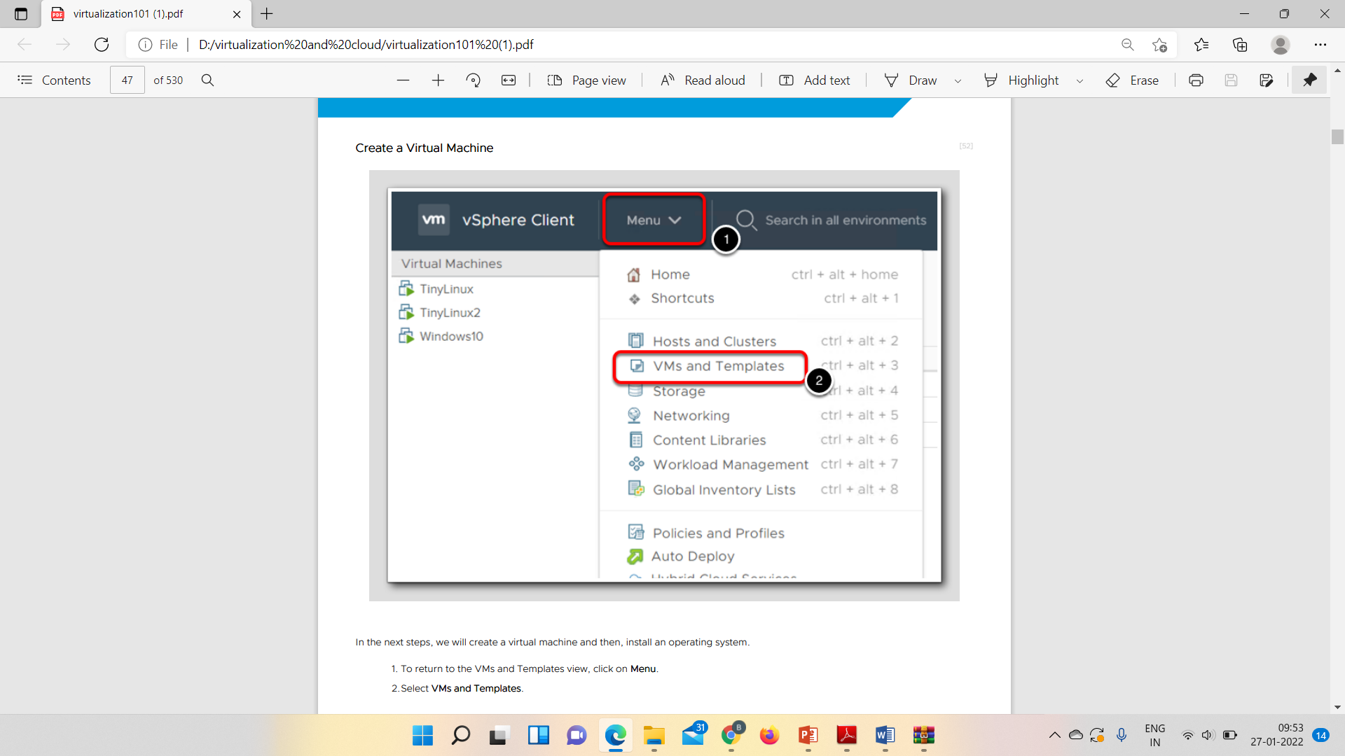
28
PART - I: VIRTUALIZATION
LAB WORK
@Mr. Ajay Kumar Badhan

Slide 29
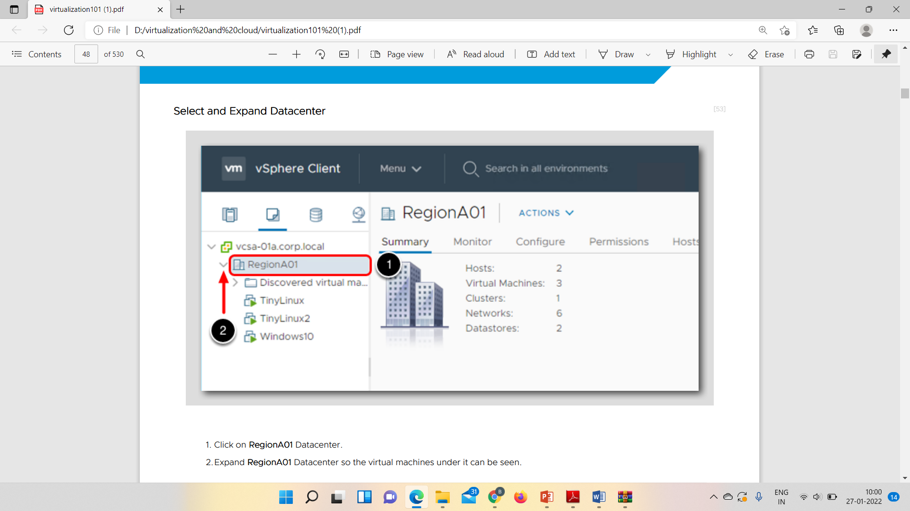
29
PART - I: VIRTUALIZATION
LAB WORK
@Mr. Ajay Kumar Badhan

Slide 30
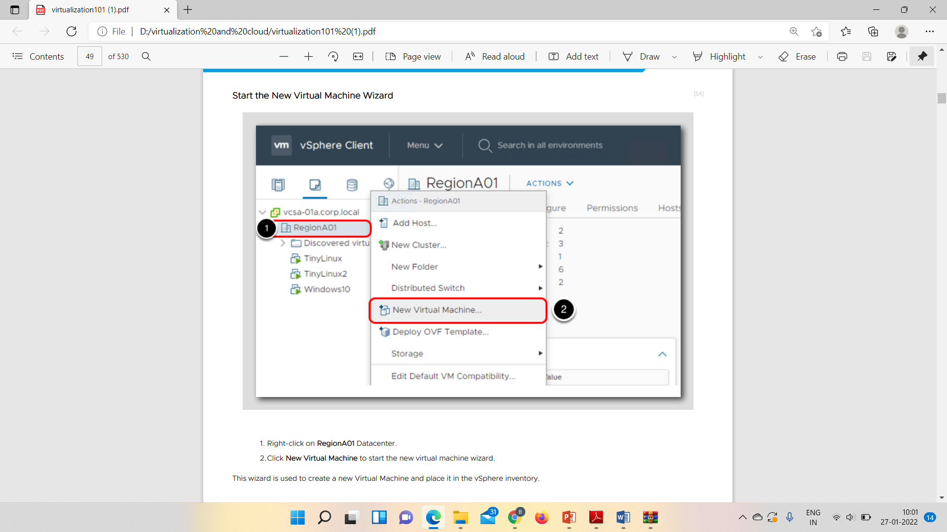
30
PART - I: VIRTUALIZATION
LAB WORK
@Mr. Ajay Kumar Badhan

Slide 31
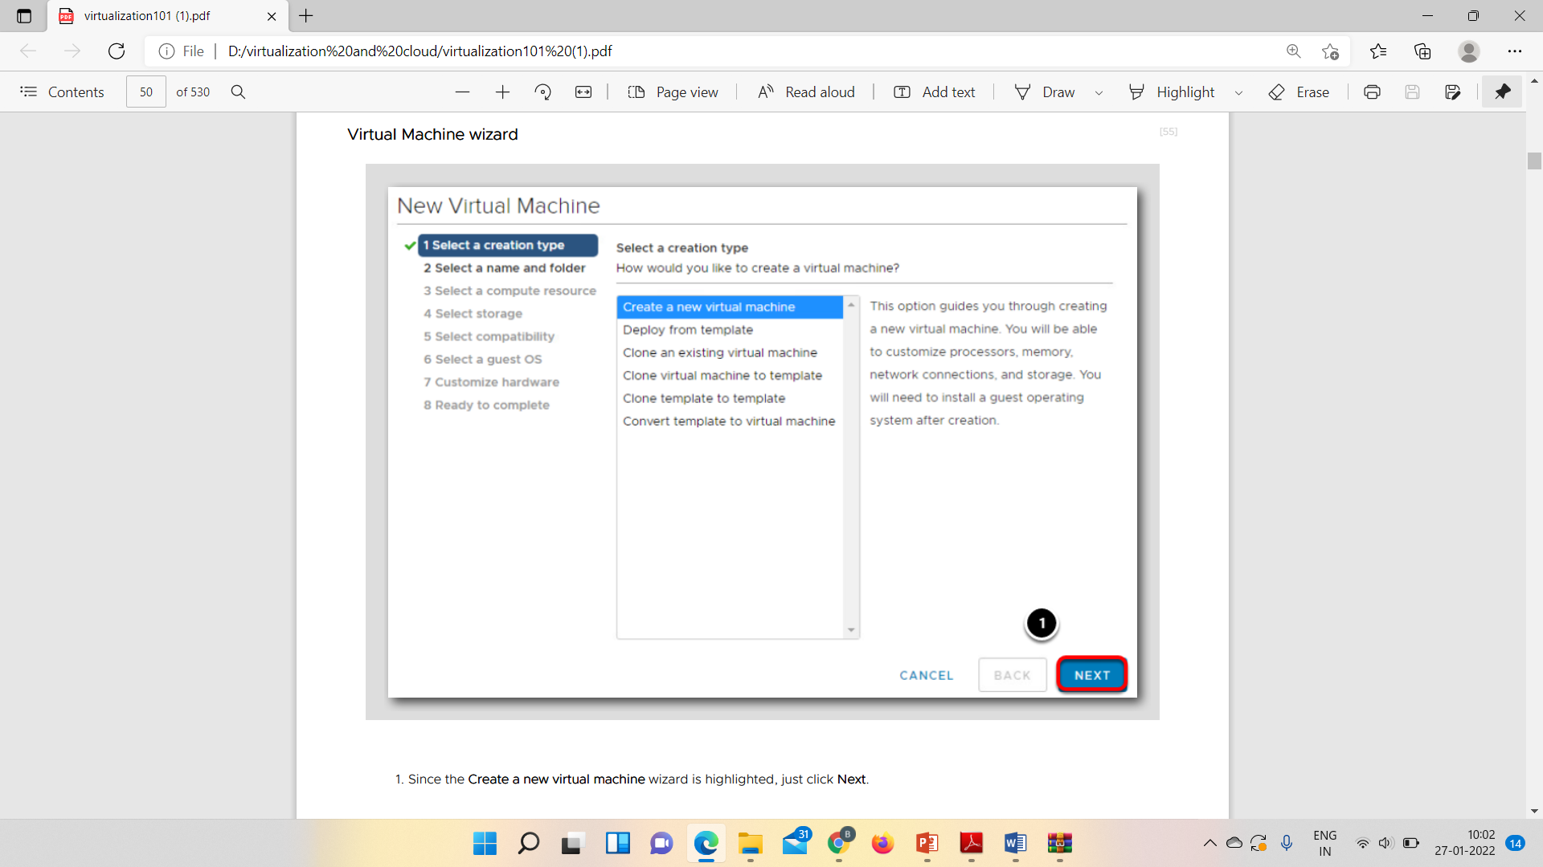
31
PART - I: VIRTUALIZATION
LAB WORK
@Mr. Ajay Kumar Badhan

Slide 32
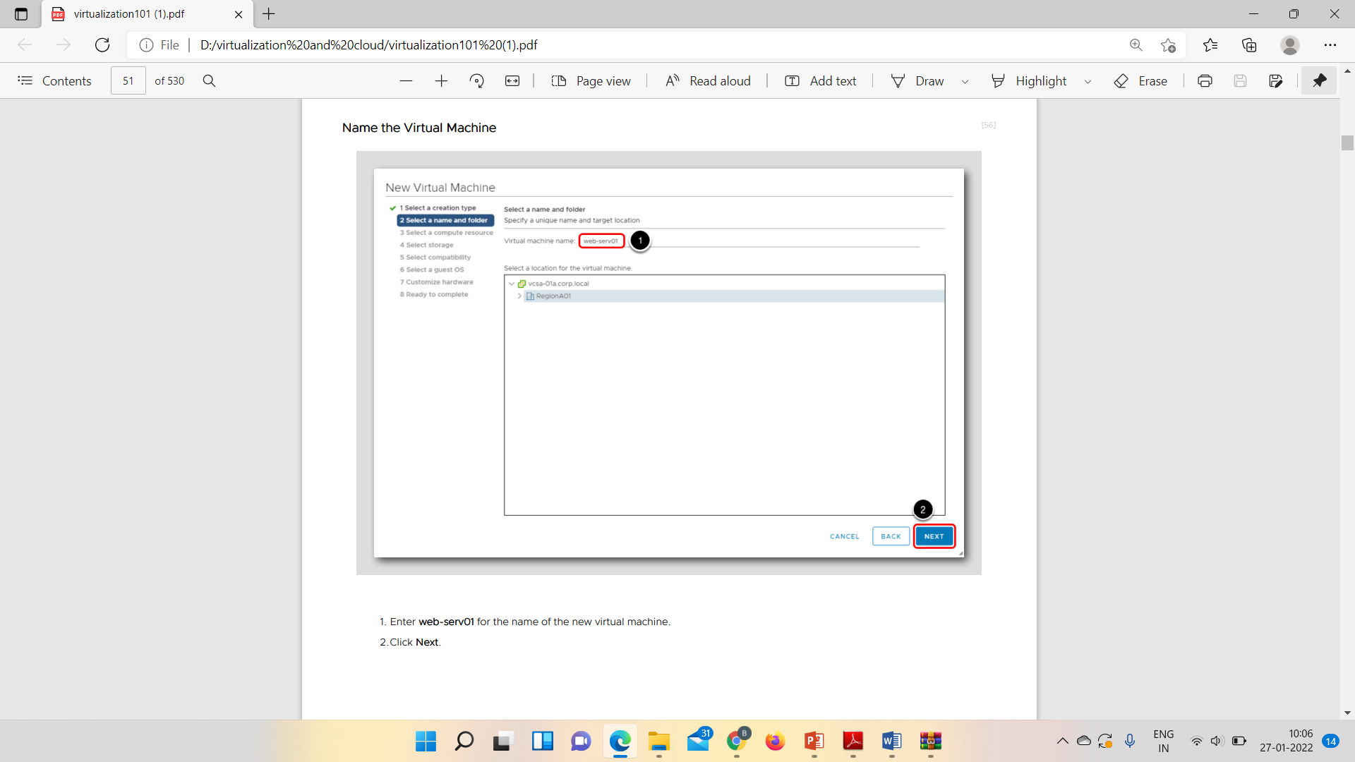
32
PART - I: VIRTUALIZATION
LAB WORK
@Mr. Ajay Kumar Badhan

Slide 33
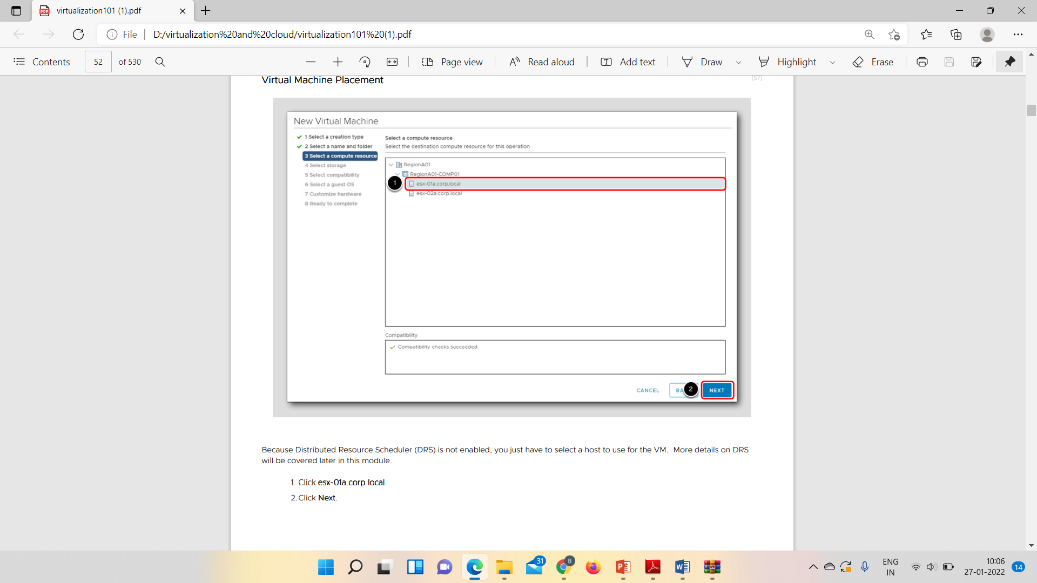
33
PART - I: VIRTUALIZATION
LAB WORK
@Mr. Ajay Kumar Badhan

Slide 34
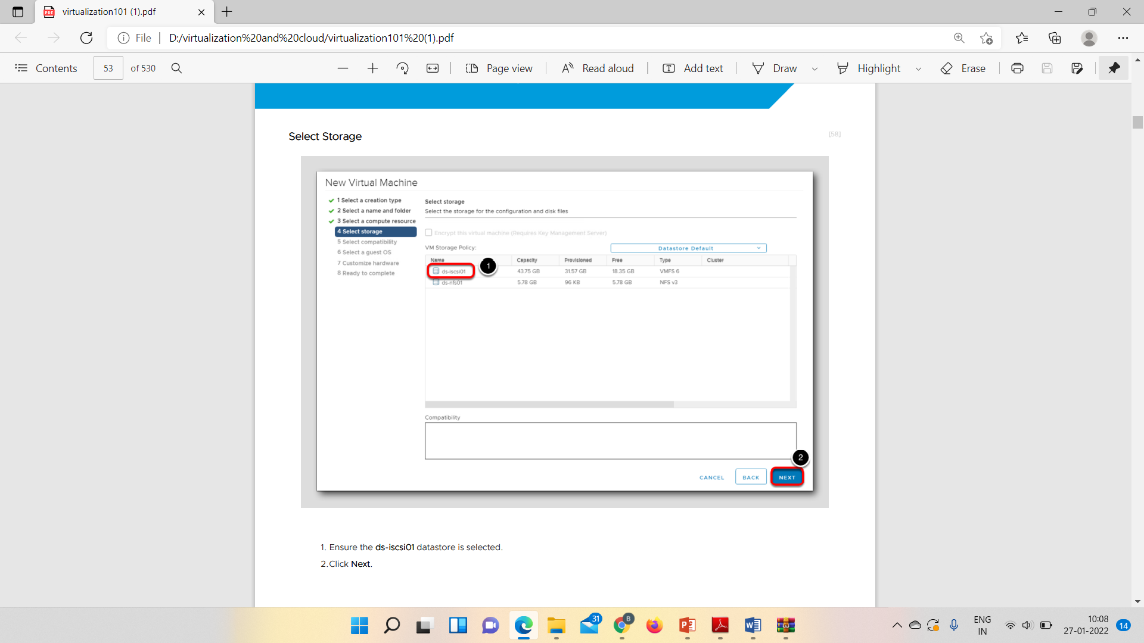
34
PART - I: VIRTUALIZATION
LAB WORK
@Mr. Ajay Kumar Badhan

Slide 35
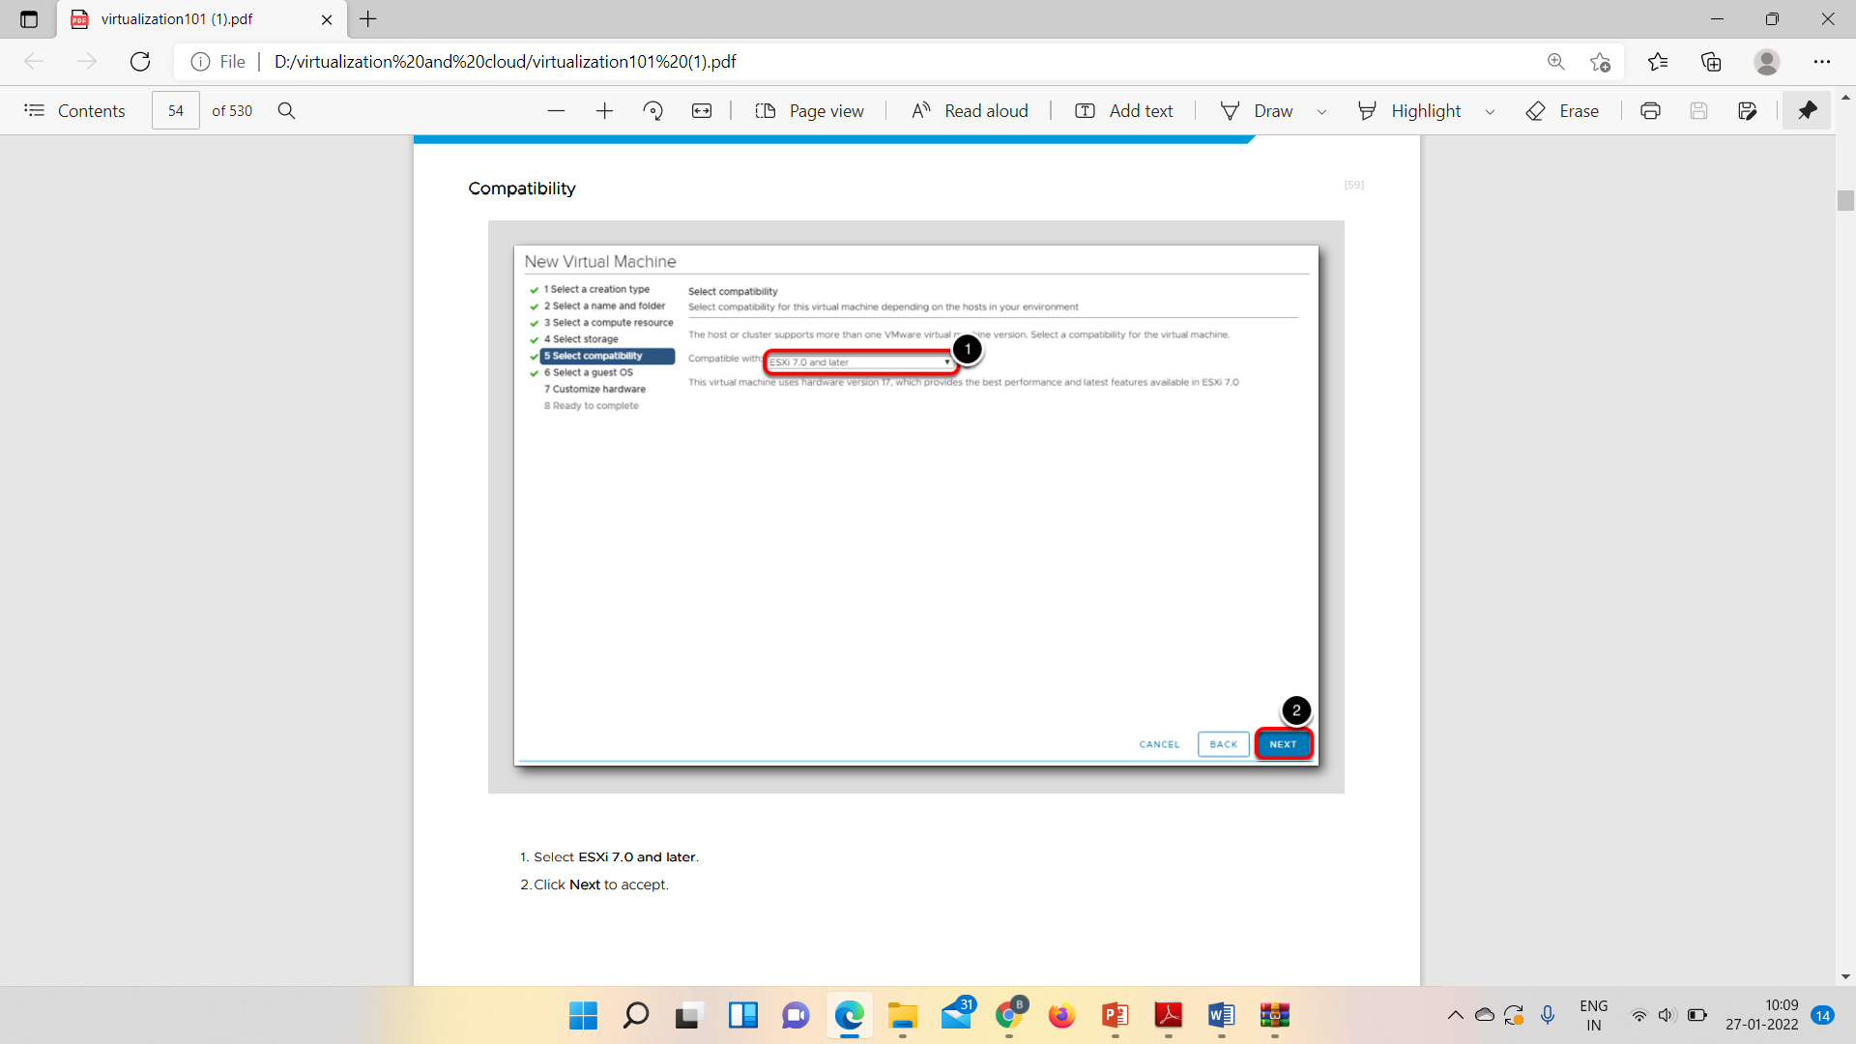
35
PART - I: VIRTUALIZATION
LAB WORK
@Mr. Ajay Kumar Badhan

Slide 36
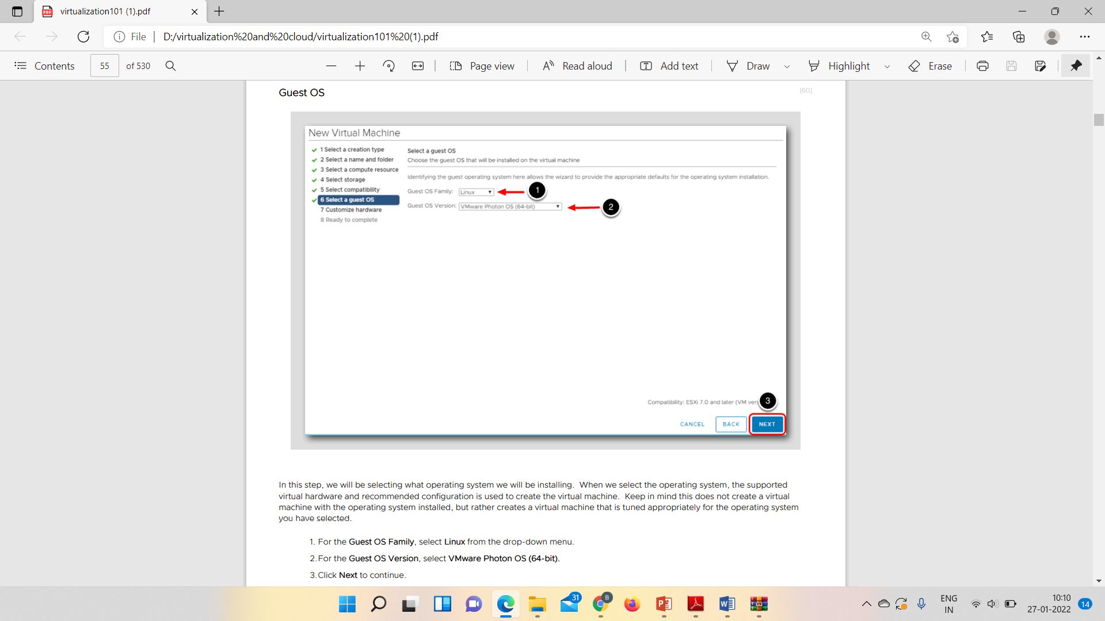
36
PART - I: VIRTUALIZATION
LAB WORK
@Mr. Ajay Kumar Badhan

Slide 37
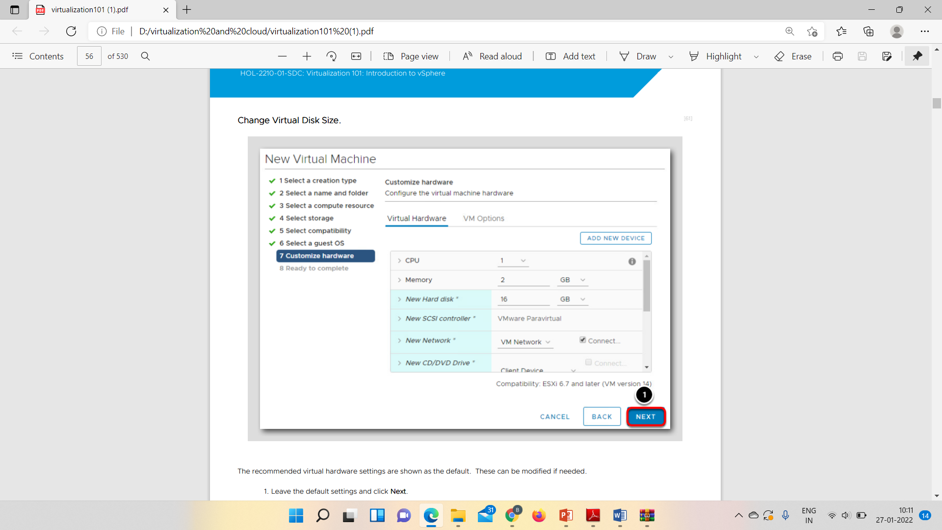
37
PART - I: VIRTUALIZATION
LAB WORK
@Mr. Ajay Kumar Badhan

